Slide 1
Identifying Metabolic Signatures of
High-Producing Antibody CHO Clones
Flux Balance Analysis of 9 antibody-producing clones
iCHO3K metabolic model · Day 7→10 metabolic rates · FBA / FVA / pFBA
Team Meeting

Slide 2
PART 1 · MOTIVATION
Same antibody — why do clones differ in yield?
● We have 9 CHO clones producing the same antibody
● After 14-day culture, titers differ greatly between clones
– Clone08: ~12,000 mg/L (highest)
– Clone07: ~7,800 mg/L (lowest) → ~1.5× difference
● Is this because cells use nutrients differently?
● Analyzing metabolic differences may reveal common traits of high producers
Highest producer (Clone08)
12,000
mg/L
Lowest producer (Clone07)
7,800
mg/L
CHO cell line metabolic analysis | negative = uptake, positive = secretion
2

Slide 3
PART 1 · MOTIVATION
Goals of this analysis
01
02
03
Map metabolic patterns
Link pathways to yield
Design next experiments
Quantify how high producers
consume/secrete nutrients
Statistically identify pathways
associated with productivity
Pre-screen gene-engineering
and media-optimization targets
Honest premise: FBA is not a tool to predict clone titer ranking. The goal is to understand the metabolic state —
focusing on mechanism, not prediction. (See slide 7 for why.)
CHO cell line metabolic analysis | negative = uptake, positive = secretion
3

Slide 4
PART 2 · FBA BACKGROUND
Metabolic network = a vast road system inside the cell
● A cell is a "chemical factory" of thousands of reactions
– Glucose and amino acids go in (uptake)
– → ATP (energy), proteins, antibody come out (secretion)
● The iCHO3K model maps all these reactions
– 8,368 reactions, 4,695 metabolites
● Analogy: a city road network
– Metabolites = cars on the road
– Reactions = the roads the cars travel
City = Cell
Glucose
Amino acids
→
Metabolic
network
→
Antibody
ATP
We can only measure traffic at the city
entrance/exit (medium concentration changes).
What routes the cars take inside
cannot be observed directly.
CHO cell line metabolic analysis | negative = uptake, positive = secretion
4

Slide 5
PART 2 · FBA BACKGROUND
FBA: inferring internal flux from inputs and outputs
Flux Balance Analysis (FBA) = compute unmeasurable internal flux from measurable inputs/outputs
Measurable
FBA compute
Unmeasurable → inferred
→
→
Glucose, lactate,
amino acid changes in medium
Mathematical optimization
estimates internal flux
Internal flux: TCA,
glycolysis, etc.
Analogy: Knowing only entrance/exit traffic, plus the road map (model) and the assumption that "cars flow efficiently
without congestion," we can back-calculate traffic on each internal road. That is exactly what FBA does.
CHO cell line metabolic analysis | negative = uptake, positive = secretion
5

Slide 6
PART 2 · FBA BACKGROUND
Three core assumptions of FBA
Steady state
Internal metabolite concentrations stay constant.
Amount in = amount out (no accumulation)
Steady-state
Objective function
The cell is assumed to maximize something —
usually growth (biomass) or antibody production (IgG)
Objective
Constraints
Measured uptake/secretion rates set flux bounds.
Medium concentration defines the "hard limits"
Constraints
CHO cell line metabolic analysis | negative = uptake, positive = secretion
6

Slide 7
PART 2 · FBA BACKGROUND
★ What FBA can and cannot do
✓ CAN do
✗ CANNOT do
● Characterize metabolic state (active pathways)
● Estimate feasible flux ranges (FVA)
● Identify gene/reaction knockout targets
● Simulate media composition optimization
● Infer unmeasurable internal flux
● Predict clone titer ranking
– All clones share the same stoichiometry → identical FBA objective values
● Reflect transcriptome (expression) differences
– Same model = same reactions
● → Clone differences need RNA-seq or other data
CHO cell line metabolic analysis | negative = uptake, positive = secretion
7

Slide 8
PART 2 · FBA BACKGROUND
A toy example: steady state means S·v = 0
v3
Steady state: for every metabolite, in = out
v1
A
v2
B
C
v6
product
A :
v1 − v2 = 0
B :
v2 − v3 − v4 = 0
v4
v5
C :
v3 + v5 − v6 = 0
D
D :
v4 − v5 = 0
In matrix form:
v1: uptake of A v2: A→B v3: B→C (direct)
v4: B→D v5: D→C (detour) v6: C→ product (objective)
S · v = 0
S = stoichiometry matrix (metabolites × reactions)
v = flux vector (what we solve for)
FBA adds an objective (maximize v6) and solves S·v = 0 for the best flux v.
CHO cell line metabolic analysis | negative = uptake, positive = secretion
7b

Slide 9
PART 2 · FBA BACKGROUND
FBA finds one answer, FVA finds the range
FBA — one optimal solution
But is that the only answer?
Maximize v6 subject to S·v = 0, v1 ≤ 10
No. The cell could also route through the detour
(v4→v5) and still make v6 = 10.
Many flux vectors give the same objective —
FBA just reports one of them.
v1=10 v2=10 v3=10
v4=0 v5=0 v6=10
→ max product v6 = 10
FVA — feasible range of each flux at ≥ 90% of max objective
v1
[9, 10] uptake fixed (tight)
v2
[9, 10] fixed (tight)
v3
[0, 10] direct path — free (0–10)
v4
[0, 10] detour — free (0–10)
v6
[9, 10] product fixed (tight)
0
10
Narrow bar (teal) = flux is essential / tightly determined. Wide bar (gold) = alternative routes exist.
CHO cell line metabolic analysis | negative = uptake, positive = secretion
7c

Slide 10
PART 3 · OUR PIPELINE
The full pipeline at a glance
Raw data
Step 1
Metabolic rate
Step 2
Model constraint
Step 3-4
FBA·FVA
Step 5
Interpret
▶
▶
▶
▶
VCD · IgG
Glucose, lactate, 20 AA
Feed correction
mmol/gDCW/h
Input measurements
to iCHO3K
Flux distribution
+ ranges
KO · internal
metabolism
Core flow: Experimental measurements (input) → convert to per-cell metabolic rates → apply as model constraints
→ compute internal flux by optimization → compare high vs low producers → derive biological meaning
CHO cell line metabolic analysis | negative = uptake, positive = secretion
8

Slide 11
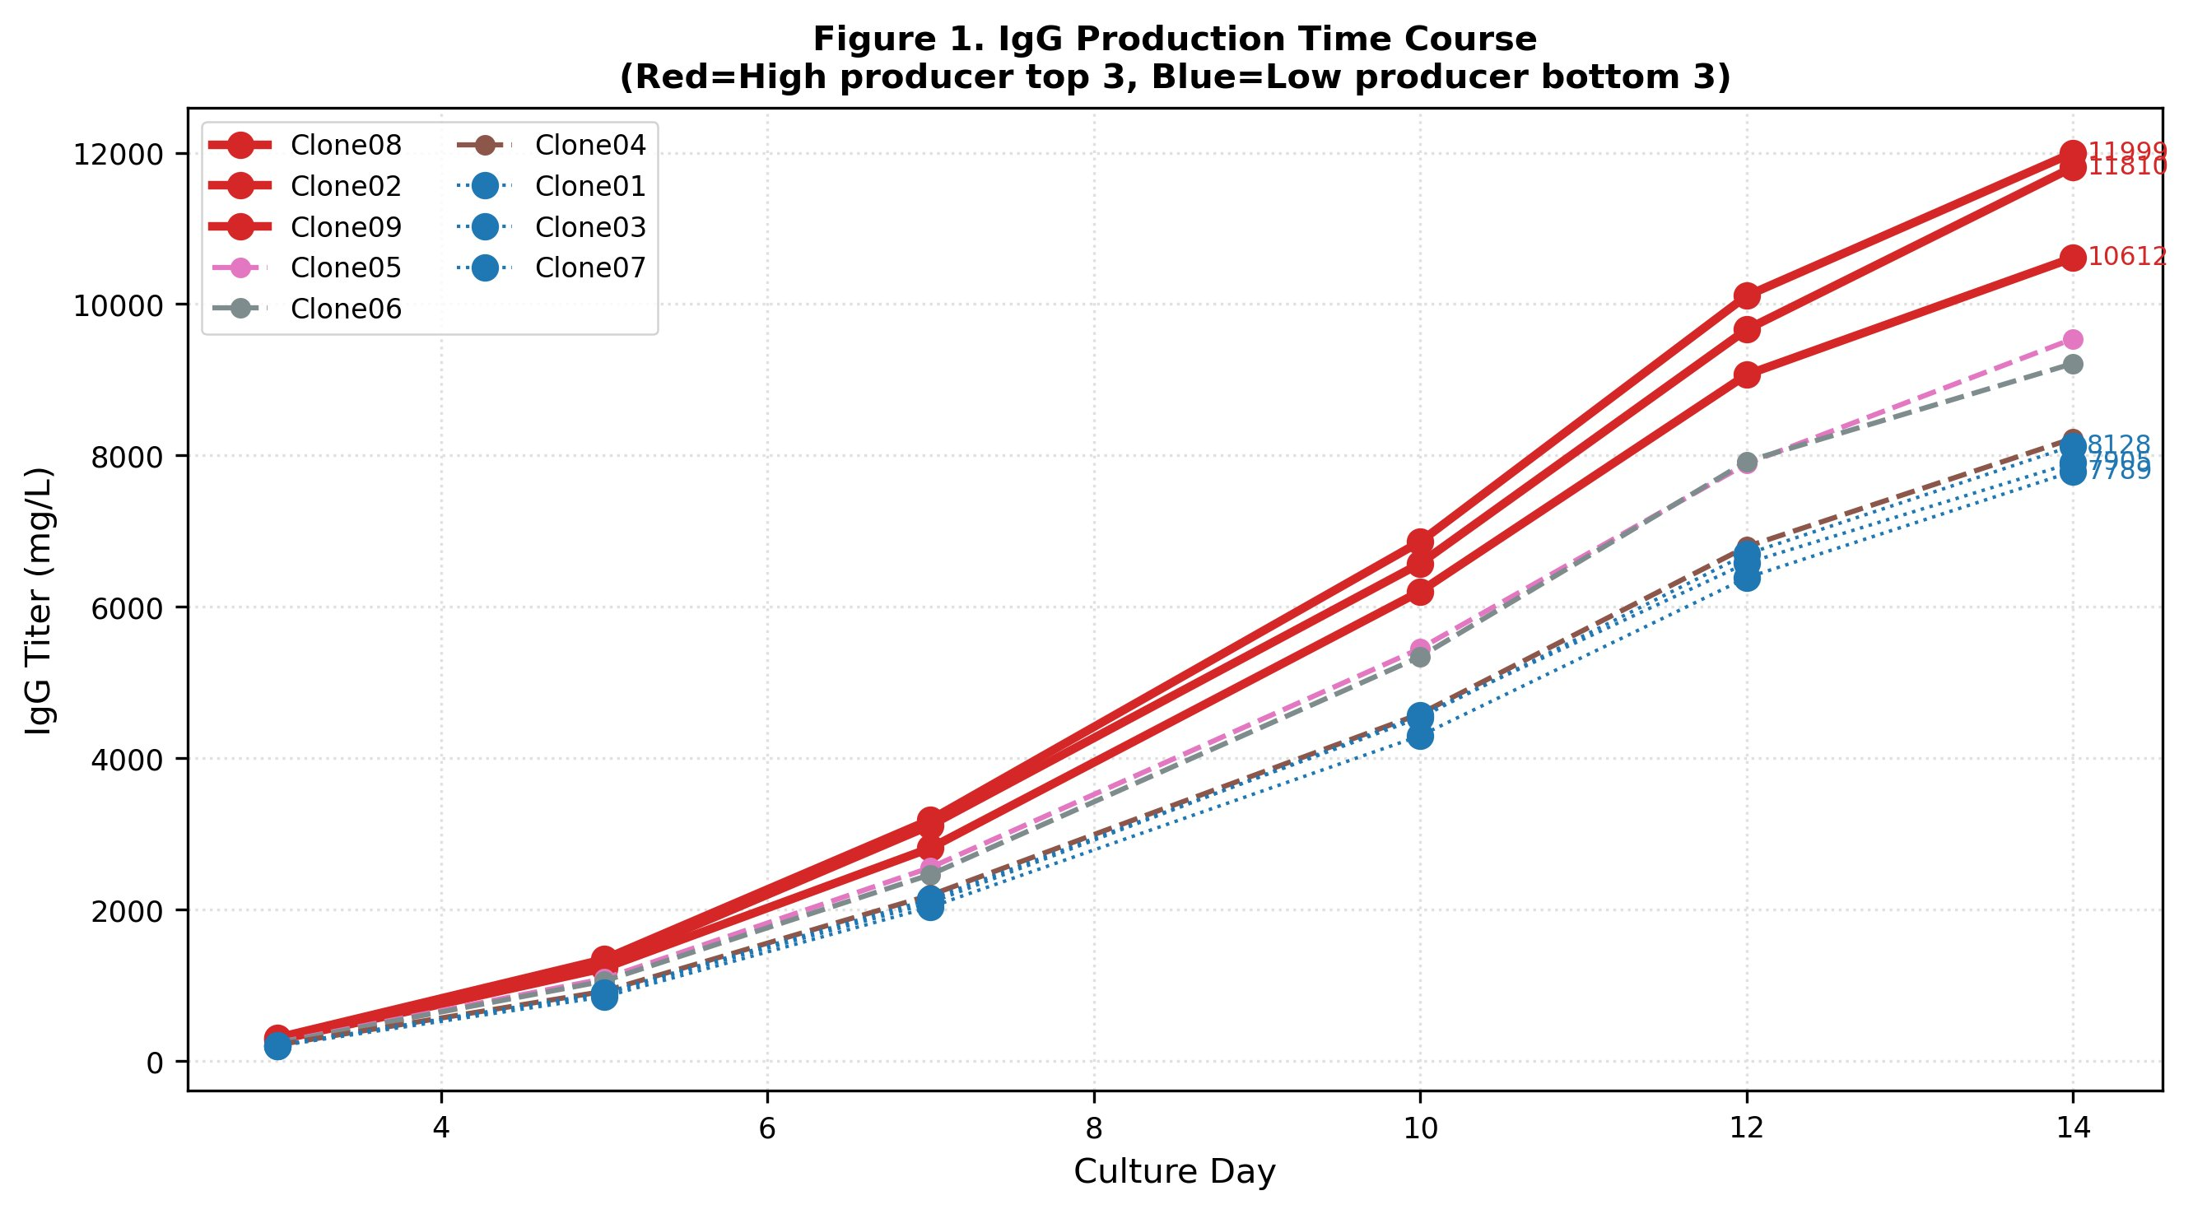
PART 3 · OUR PIPELINE
Step 1. Measurements → metabolic rates
● Measured variables
– VCD (viable cell density), IgG titer
– Glucose, lactate, ammonia, 20 amino acids
● Feed correction is critical
– Fed-batch adds nutrients mid-culture
– Must subtract feed to get true consumption
● Result: per-cell metabolic rate
– Unit mmol/gDCW/h (per cell mass per time)
– Day 7→10 interval used (exponential phase)
Figure 1. IgG production curves for 9 clones (red=top 3, blue=bottom 3)
CHO cell line metabolic analysis | negative = uptake, positive = secretion
9

Slide 12
PART 3 · OUR PIPELINE
Step 2. The iCHO3K metabolic model
● iCHO3K = genome-scale CHO metabolic model
– 8,368 reactions, 4,695 metabolites, 2,929 genes
– Hernandez Bort et al. (2023) NPJ Syst Biol
● Production version used (cho_prod)
– Includes IgG heavy-chain / light-chain synthesis
● Step 1 rates applied as constraints
– Uptake/secretion limits set per clone
8,368
reactions
4,695
metabolites
2,929
genes
CHO cell line metabolic analysis | negative = uptake, positive = secretion
10

Slide 13
PART 3 · OUR PIPELINE
Step 3-4. FBA & FVA
FBA
FVA
Flux Balance Analysis
Flux Variability Analysis
● Computes one optimal flux distribution
● A single solution maximizing the objective
● "What is the most efficient metabolic state under these conditions?"
● Computes the range of feasible flux
● Maximum / minimum (uncertainty width)
● Narrow range = reaction is essential Wide range = alternative routes exist
CHO cell line metabolic analysis | negative = uptake, positive = secretion
11

Slide 14
PART 3 · OUR PIPELINE
Step 5. In silico knockout screening
● "Would removing this reaction increase production?"
– Block a reaction (set to 0) in silico and recompute
● Pre-screen before actual gene-editing experiments
– Rapidly screen hundreds of candidates
– Predict success/failure to save experimental cost
● Example target
– Inhibit LDH (lactate production) → redirect flux to TCA
– Lim et al. (2010) Metab Eng — LDH KO case
KO simulation concept
Normal metabolism
↓
Remove reaction
& recompute
→ measure % change
CHO cell line metabolic analysis | negative = uptake, positive = secretion
12

Slide 15
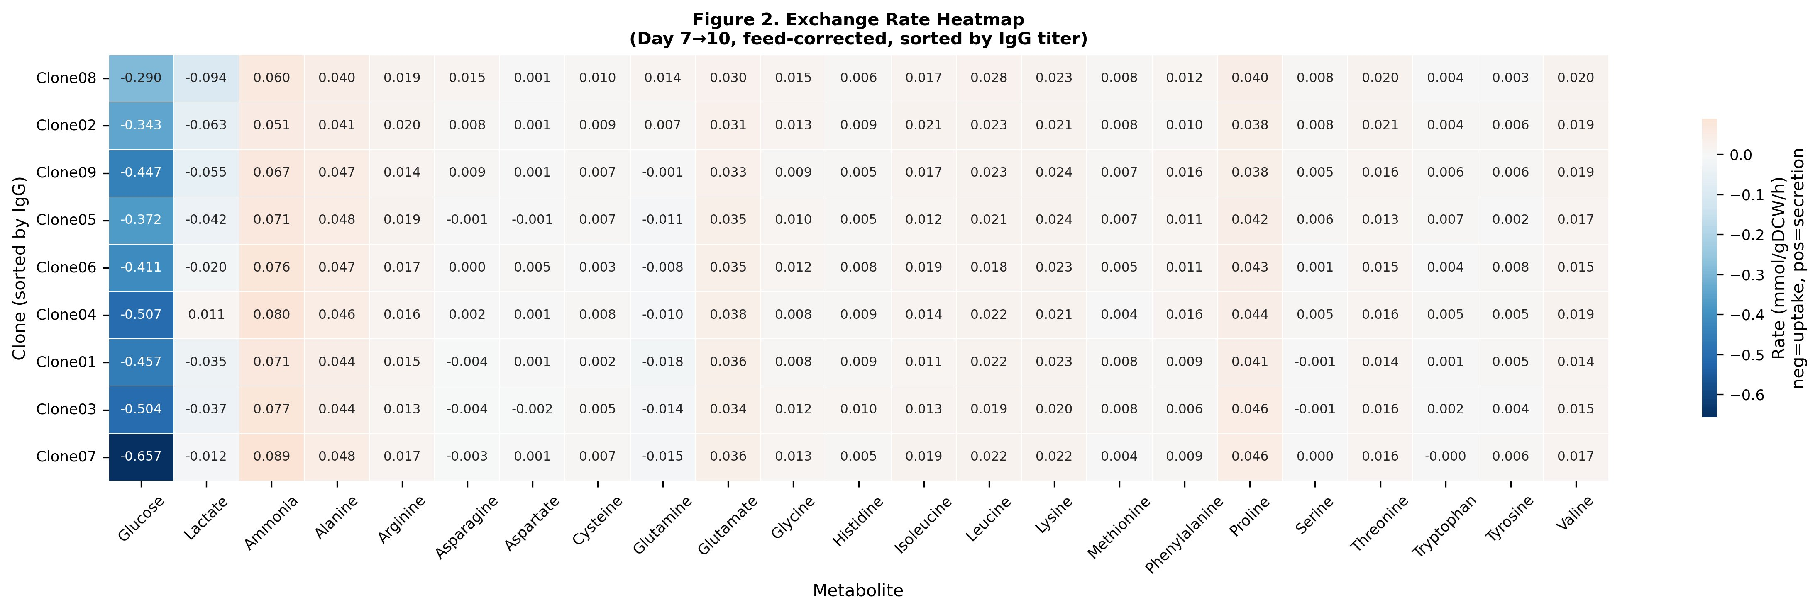
PART 4 · RESULTS
Result 1. Metabolic signature of high producers
● Rows: clones (by IgG) Cols: metabolites
● Blue = uptake Orange = secretion
● Higher producers show
– Less glucose uptake (lighter blue on top)
– Lactate re-uptake (negative values)
CHO cell line metabolic analysis | negative = uptake, positive = secretion
13

Slide 16
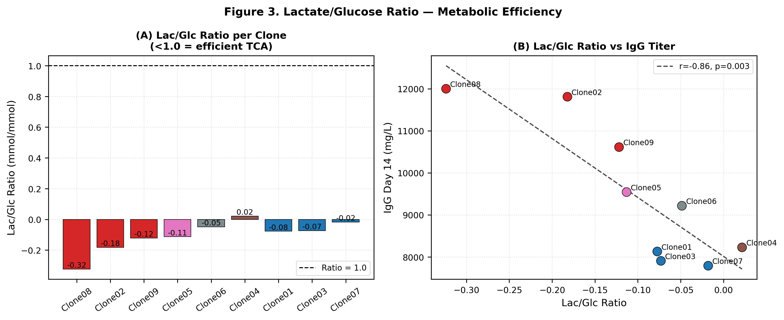
PART 4 · RESULTS
★ Result 2. Lactate/Glucose ratio — key finding
Correlation
r = −0.86
p = 0.003 (significant)
● More negative Lac/Glc ratio → higher IgG titer
● Negative = lactate re-consumed = active TCA cycle
● = efficient energy metabolism
CHO cell line metabolic analysis | negative = uptake, positive = secretion
14

Slide 17
PART 4 · RESULTS
Why does lactate re-consumption link to high yield?
Early culture (growth phase)
Late culture (production phase)
Glucose → pyruvate → lactate secreted
(Warburg effect, LDH overactive)
Inefficient fermentation for fast growth
→
Accumulated lactate re-uptaken → pyruvate
→ TCA cycle → ATP + antibody precursors
Metabolic shift
Key interpretation
High producers perform this "metabolic shift" better. Instead of discarding lactate, they recycle it as an energy source →
TCA cycle stays active → supplies enough ATP and precursors for antibody synthesis. The Lac/Glc ratio captures this shift efficiency at a glance.
CHO cell line metabolic analysis | negative = uptake, positive = secretion
15

Slide 18
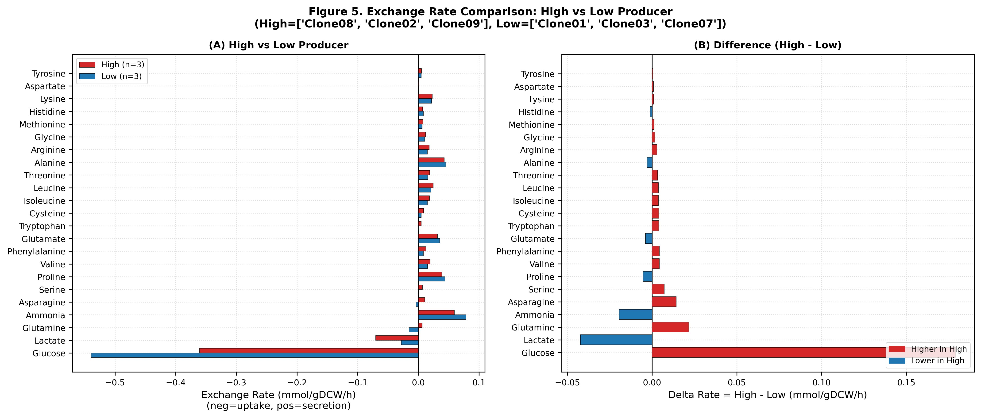
PART 4 · RESULTS
Result 3. High vs low producer comparison
● High 3 vs Low 3 group-mean comparison
● Glucose
– High uptakes less (more efficient)
● Lactate
– High re-consumes more
● Glutamine
– High utilizes more
CHO cell line metabolic analysis | negative = uptake, positive = secretion
16

Slide 19
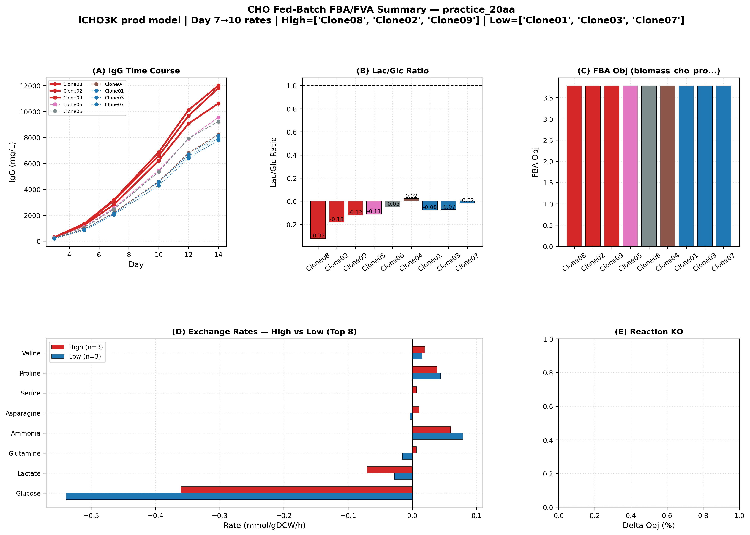
PART 4 · RESULTS
Result 4. Integrated summary panel
● A: IgG curves
● B: Lac/Glc ratio
● C: Glucose uptake
● D: Uptake/secretion High vs Low
● E: FVA flux range
● F: Extra metric
CHO cell line metabolic analysis | negative = uptake, positive = secretion
17

Slide 20
PART 5 · CONCLUSIONS
Key conclusions
1
High yield = lactate re-consumption = efficient TCA
Strong negative correlation between Lac/Glc ratio and productivity (r=−0.86)
2
FBA is a tool for understanding, not prediction
Cannot predict titer ranking; effective for mechanistic insight
3
Clone differences require additional data
Same-model limitation → transcriptome-based clone-specific models needed
CHO cell line metabolic analysis | negative = uptake, positive = secretion
18

Slide 21
PART 5 · NEXT STEPS
Future directions
RNA-seq integration
ecFBA
Media optimization
Build context-specific
models from clone
expression
→ predict clone differences
Constrain flux by
enzyme (proteome) levels
→ more realistic prediction
In silico media
composition simulation
→ productivity scenarios
Today's analysis is a starting point. Integrating the metabolic finding (lactate re-consumption) with transcriptome/proteome data can quantify high-producer selection criteria.
CHO cell line metabolic analysis | negative = uptake, positive = secretion
19

Slide 22
Thank you
Questions welcome
CHO cell line metabolic analysis pipeline · iCHO3K + FBA/FVA/pFBA

